Slide 1
Purpose, Impact, And Making
Your Data Work For You
Dr Leah Pybus
8 May 2025

Slide 2

We help organisations better understand, measure and maximise your social impact.
We develop simple and straightforward impact and measurement frameworks and use live data to help organisations tell a clearer impact story.

Slide 3

Trust Impact works with organisations to get …
Systems ready to visualise
your impact in real time
Clear on purpose
Clear on the impact you want to have
Clear on how you measure that impact

Slide 4
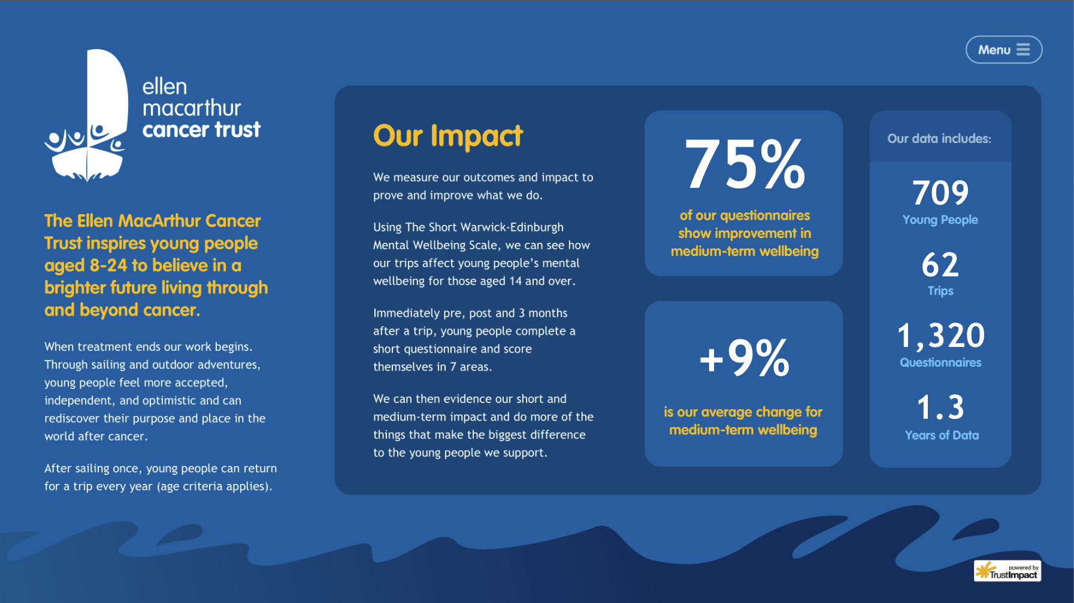
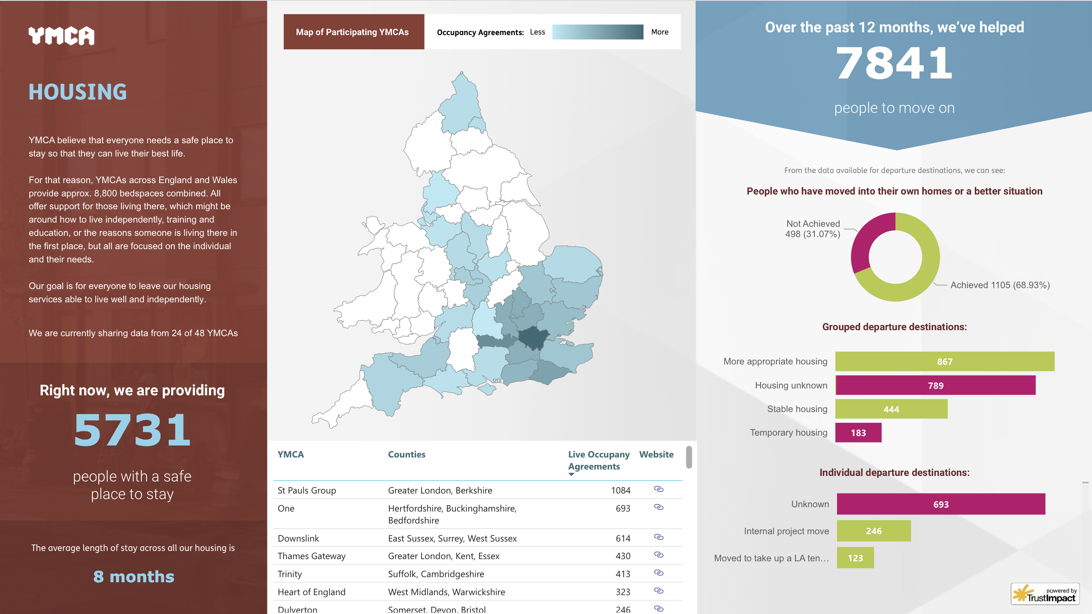
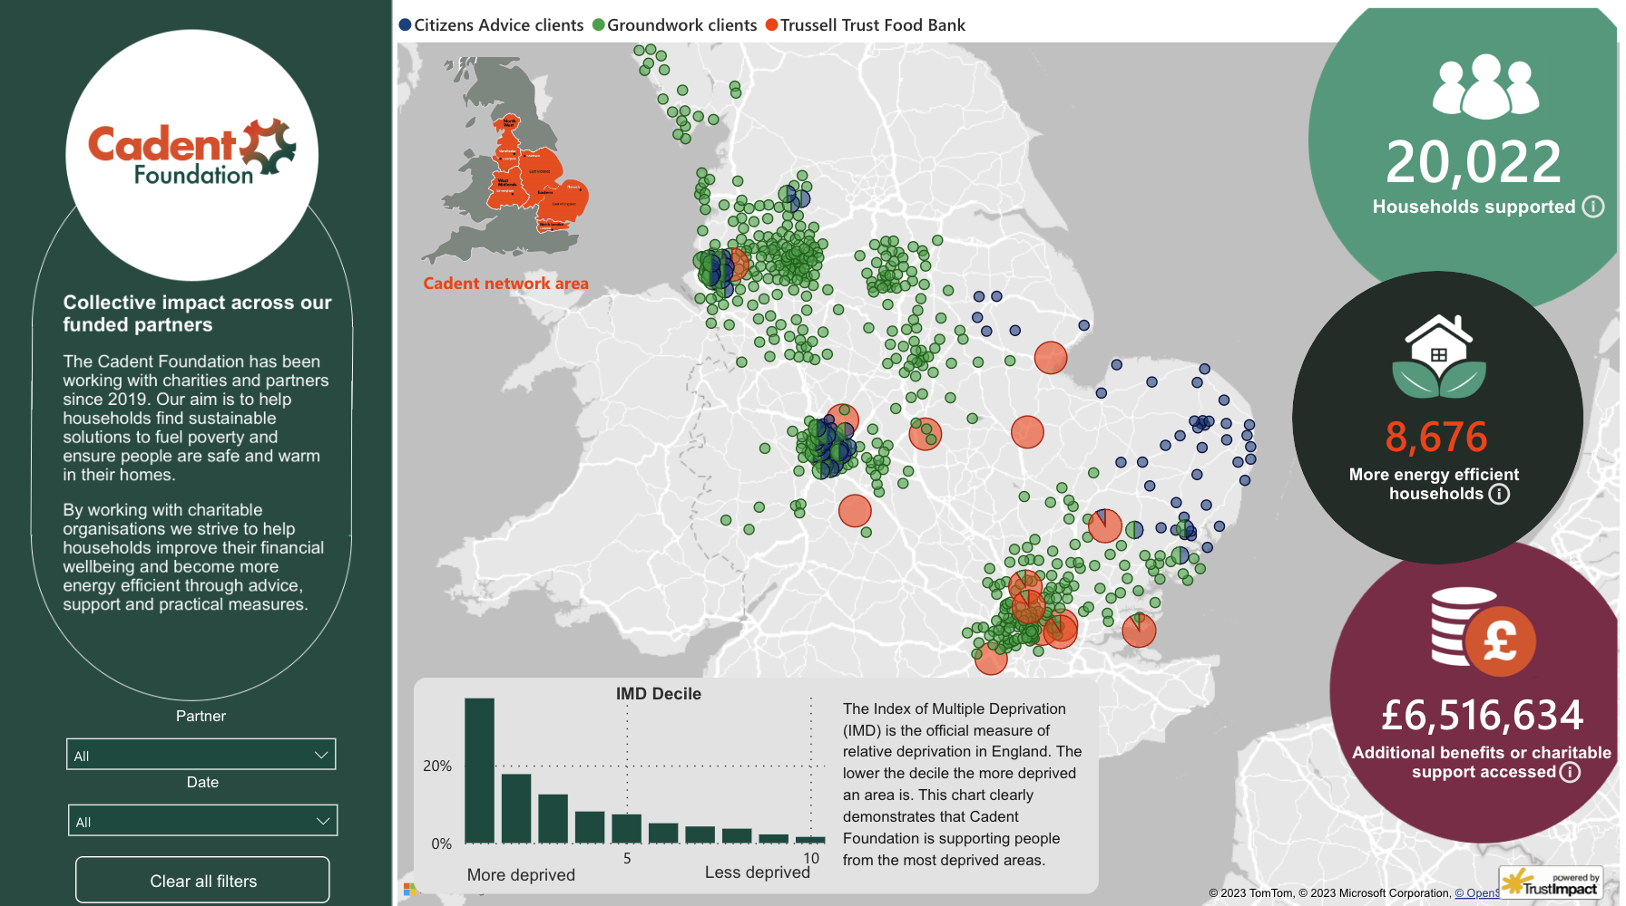
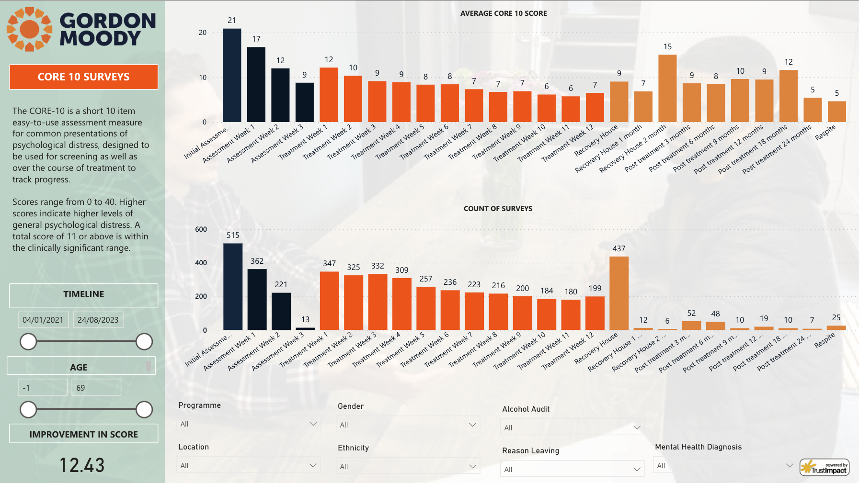
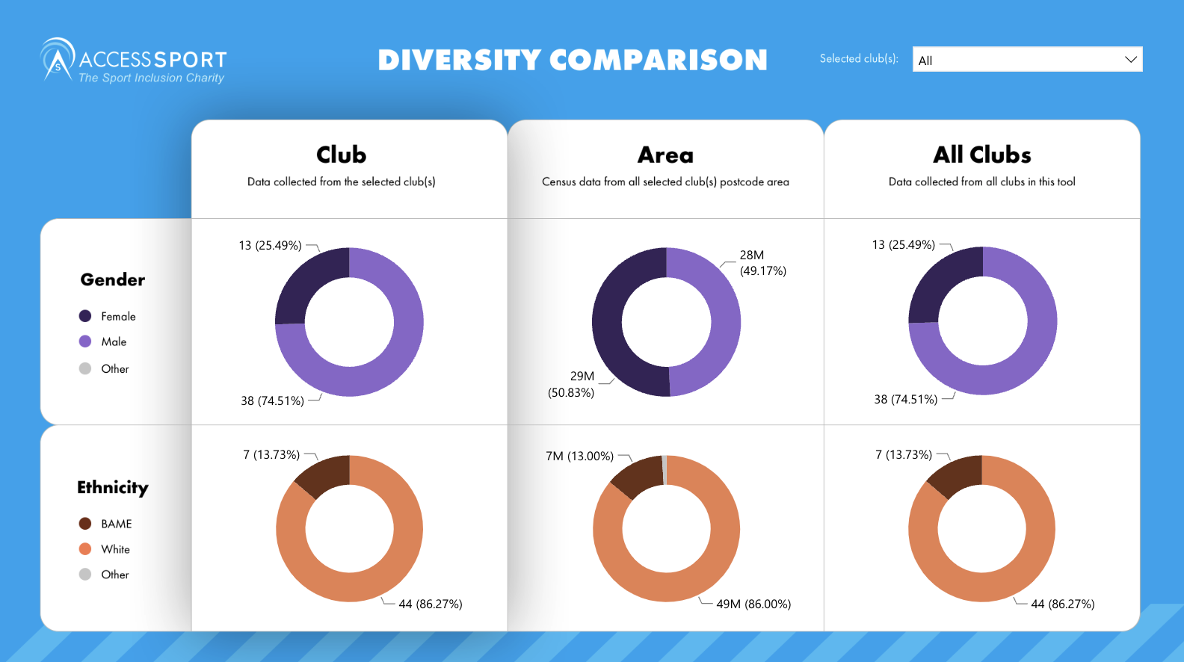
Trust Impact creates beautiful, automated, live data visualisations of the impact our clients are making, in real-time.

Slide 5
Purpose

Slide 6


Function before form – build what you need
Function
vs
form

Slide 7


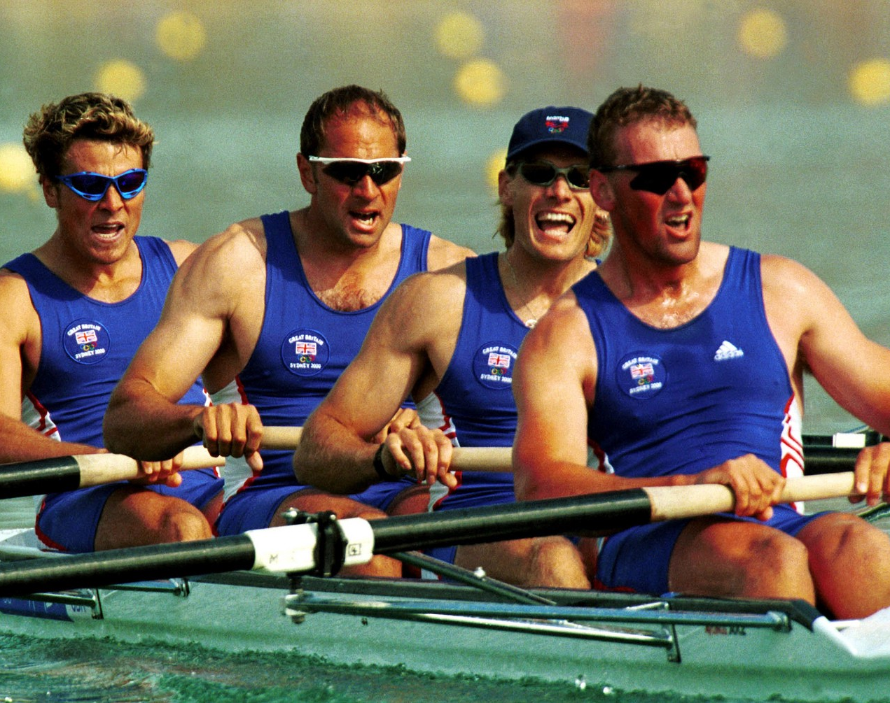
What you can achieve if function comes before form
In 1962, President John F. Kennedy visited NASA for the first time. During his tour of the facility, he met a janitor who was carrying a broom down the hallway. The President then casually asked the janitor what he did for NASA, and the janitor replied, “I'm helping put a man on the moon.”
With every decision or opportunity, every member of the British Rowing team in 2000 asked themselves:
WILL IT MAKE THE BOAT GO FASTER?

Slide 8
How Clear and Aligned Are You on Your Organisation’s Purpose?
“Can you describe the purpose of your
organisation in 8 words or less”
46%
AVERAGE ALIGNMENT ON PURPOSE

Slide 9
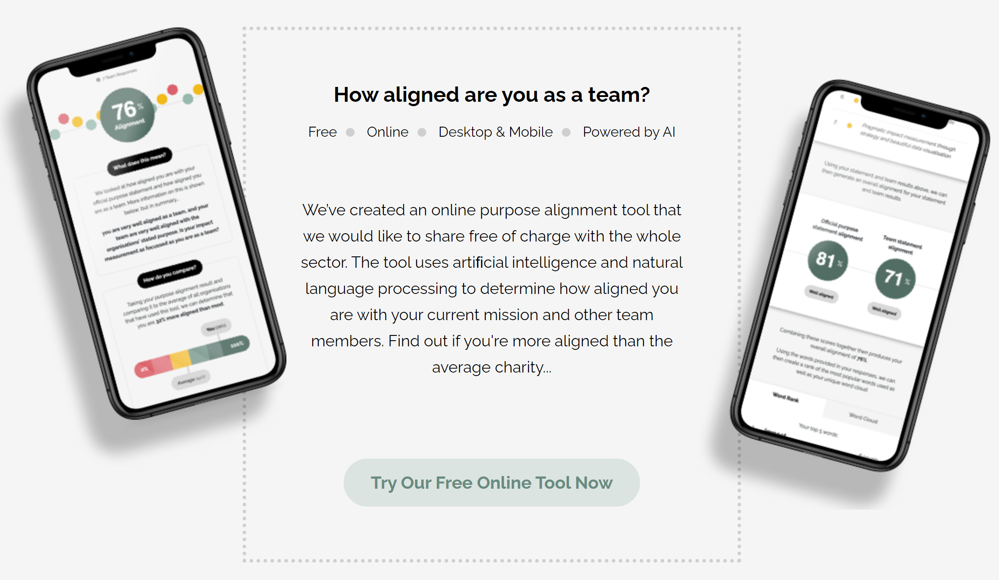
trst.uk/purpose/

Slide 10
Getting clear on function – before
NEED
(Target Population)
VISION
PURPOSE
A succinct expression of who you are here to benefit and their need(s)
A short and punchy expression of the change you want to see in society
Your role in achieving that change (how you will achieve your vision)
Environment, STEM, Poverty, Education, Net-Zero, Hydrogen
To make a positive and lasting difference to local communities and the wider society
To make a positive difference by partnering with organisations on initiatives that will enable long-term public benefit, as well as delivering grants to organisations, charities and trusts via our charity partner​

Slide 11

Getting clear on function - after
NEED
(Target Population)
VISION
PURPOSE
A succinct expression of who you are here to benefit and their need(s)
A short and punchy expression of the change you want to see in society
Your role in achieving that change (how you will achieve your vision)
People living in fuel poverty
A future without fuel poverty
To help households find sustainable solutions to fuel poverty

Slide 12
Impact

Slide 13
Are you having impact?
How do you know?

Slide 14
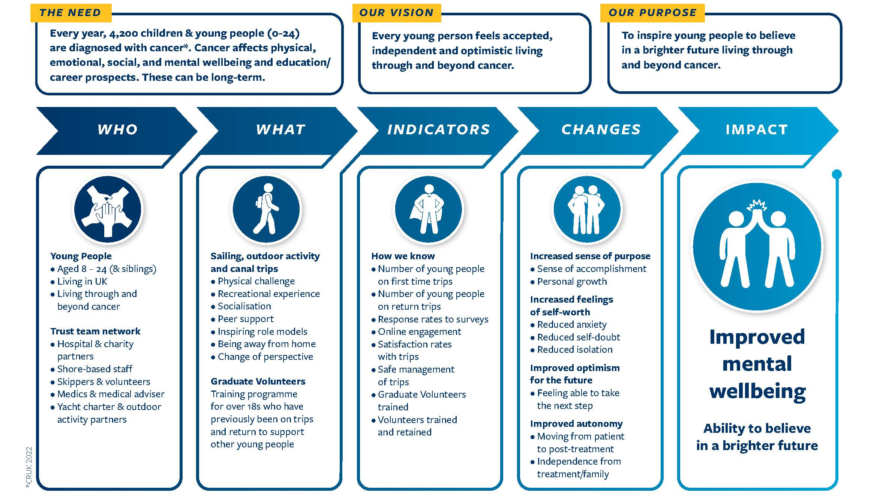
Ellen MacArthur Cancer Trust
Develop your Theory of Change – Function/Why?
Deliver your Theory of Change – Form/How?

Slide 15
Why does it matter?

Slide 16

How does this help me?
Simple clear messaging to funders and clients
Shared internal ambition about what you are trying to achieve – clear what you don’t do
Improved connectivity across what you do
More focused use of resources, not spread thin
Better able to clearly measure success and demonstrate the value of what you do
Greater freedom to learn about what works and what doesn’t – adapt and stay relevant

Slide 17
The power of data …

Slide 18
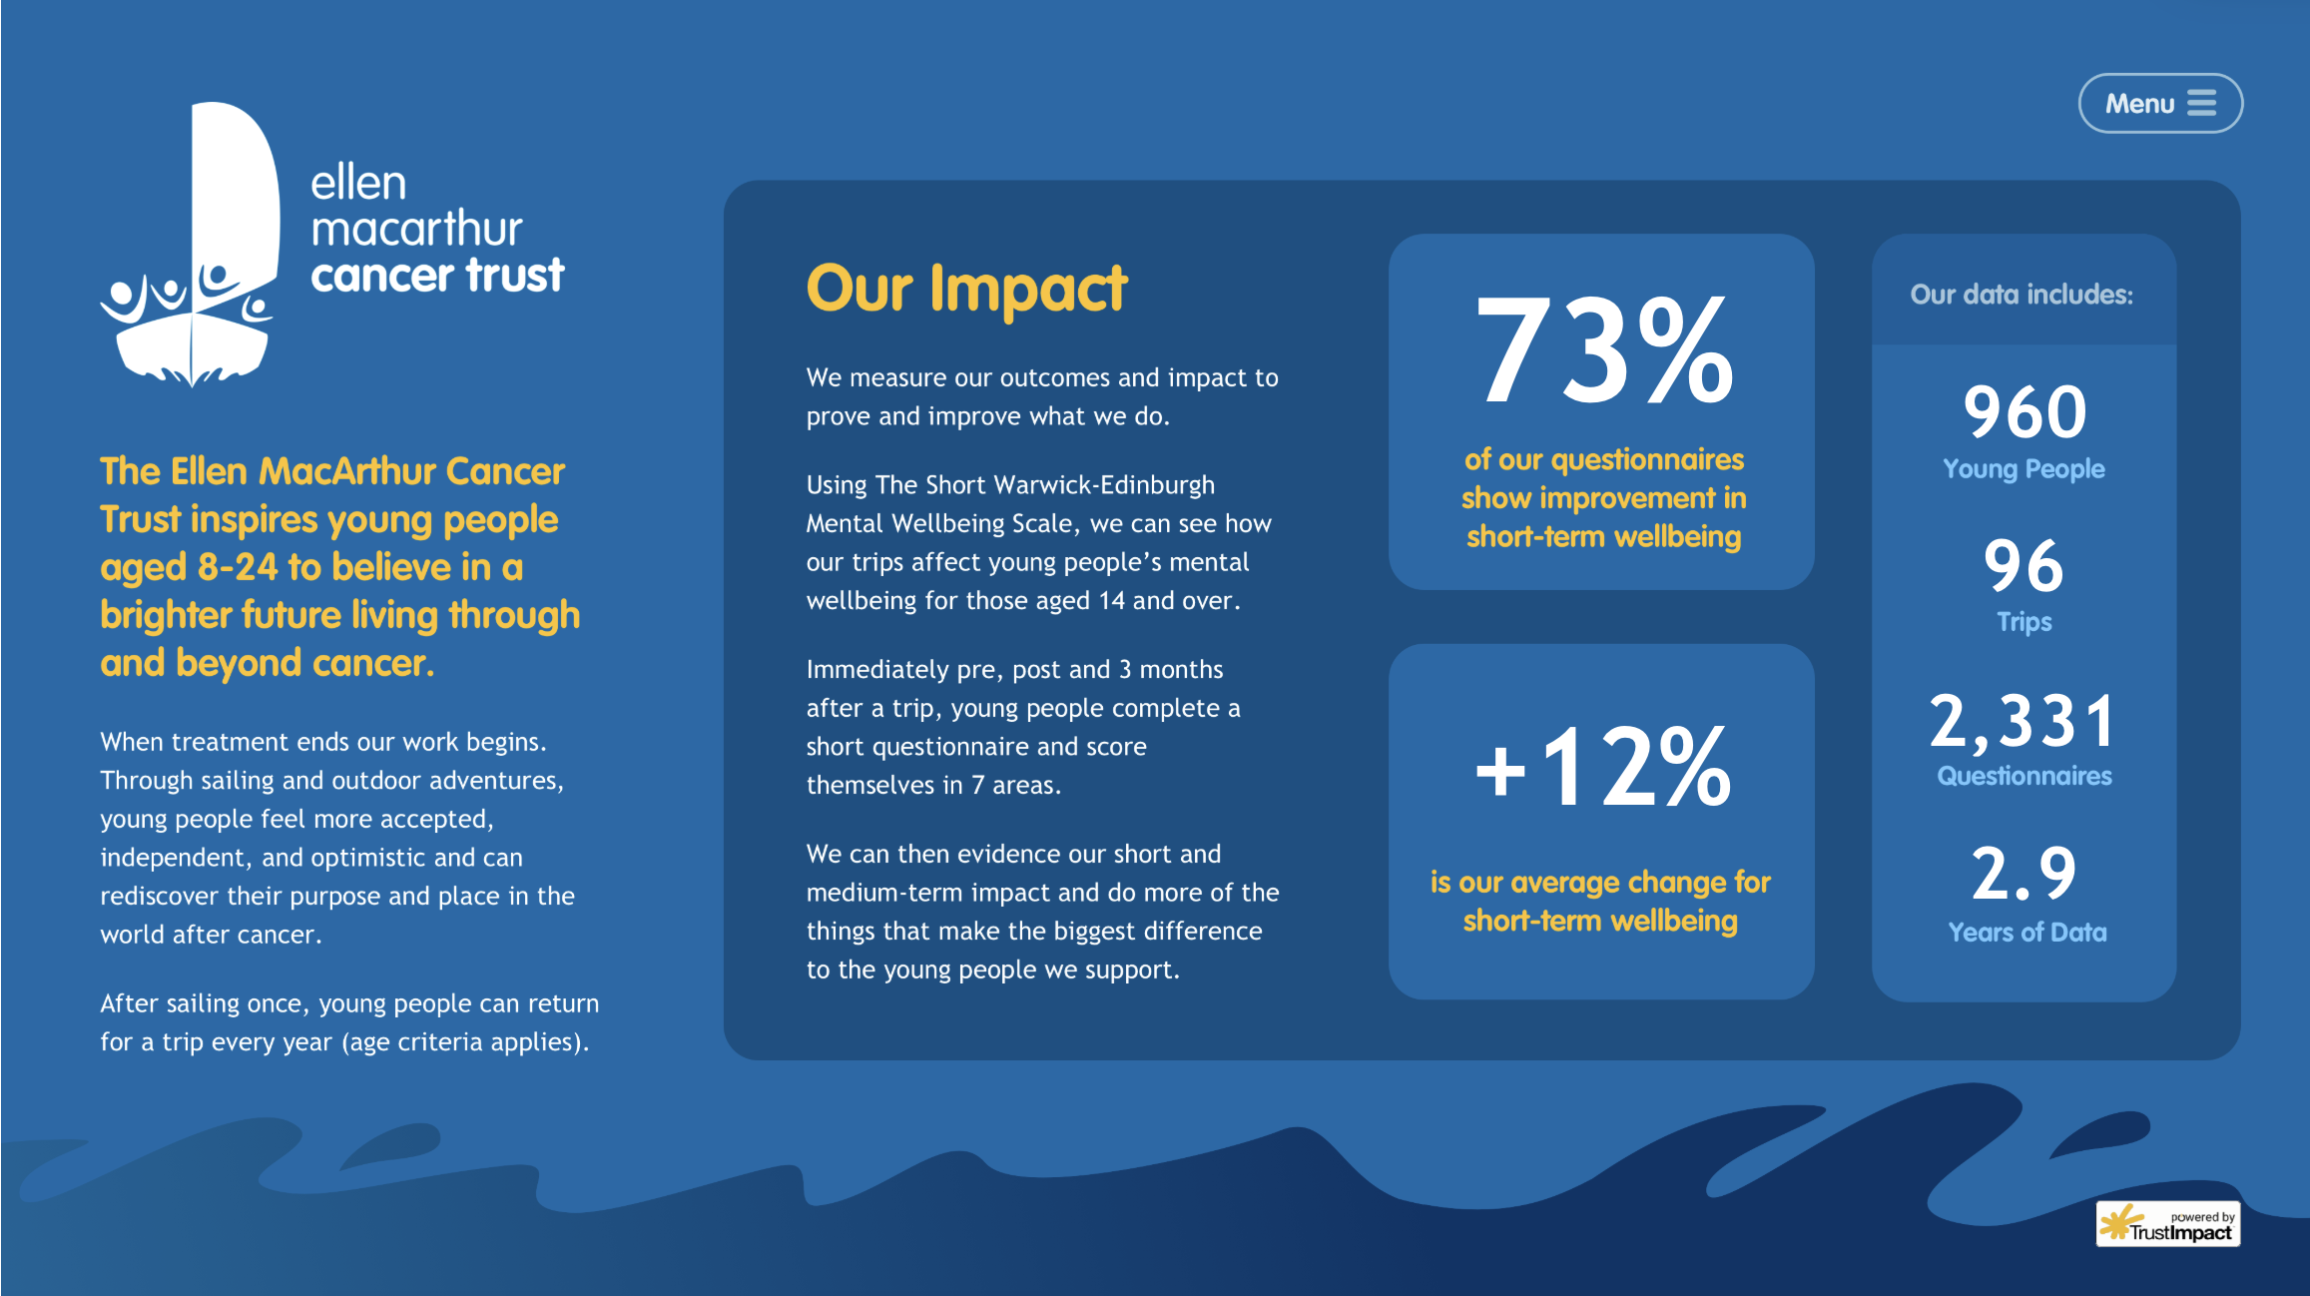
https://www.ellenmacarthurcancertrust.org/impact/
https://www.streetleague.co.uk/about

Slide 19
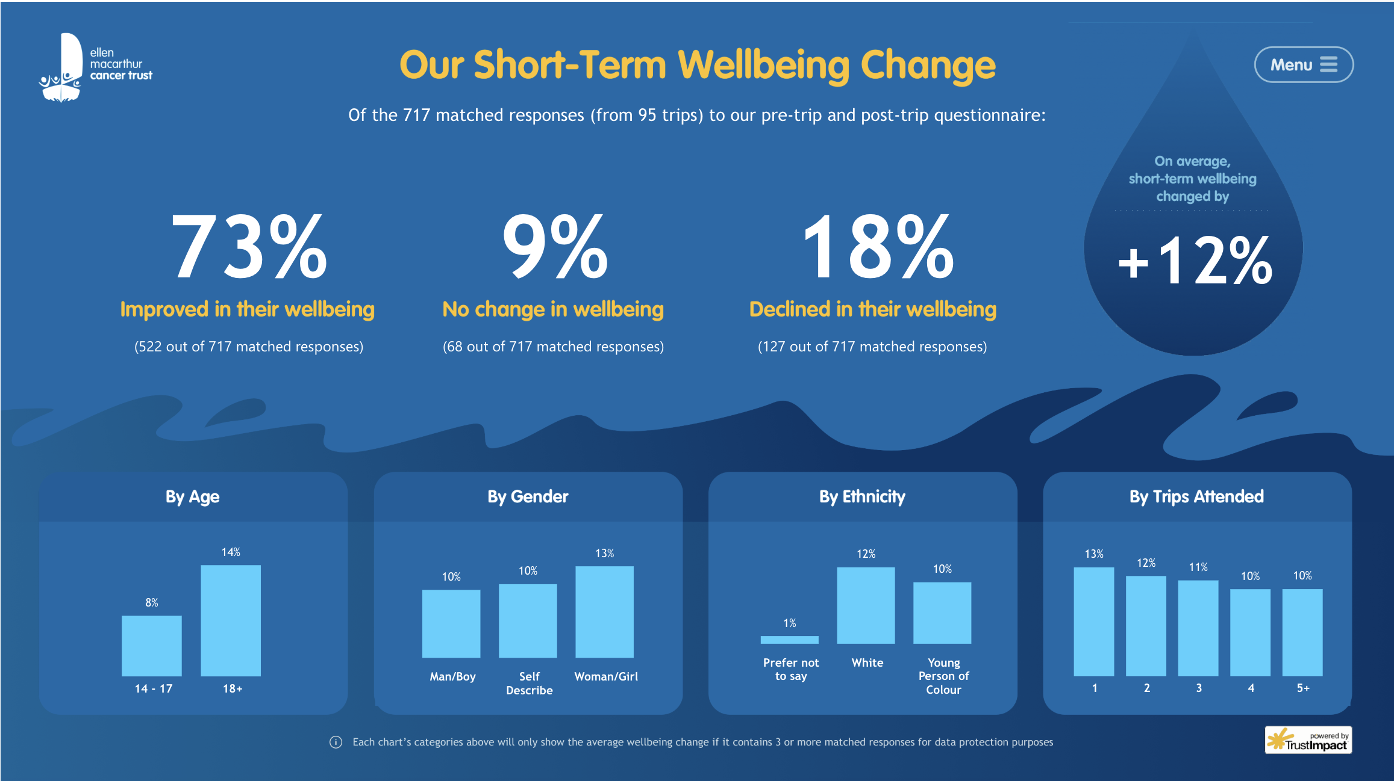
https://www.streetleague.co.uk/about

Slide 20
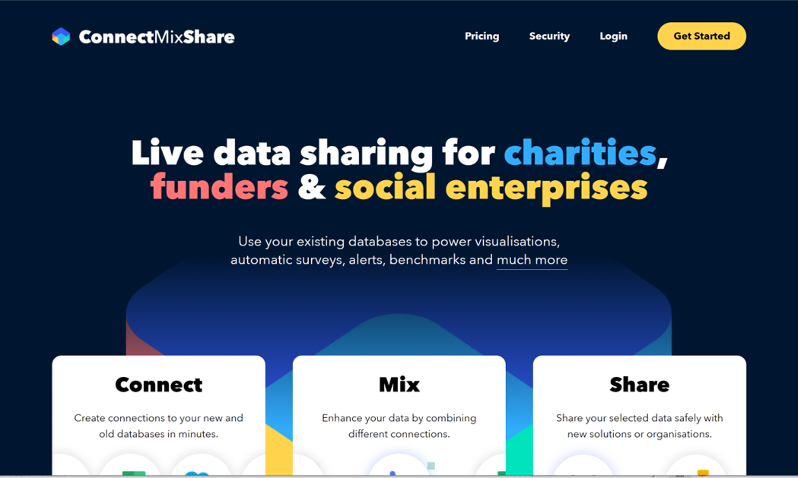

Slide 21
Why is demonstrating impact so difficult?

Slide 22
Why is it so difficult?
People are complicated! We operate in eco-systems. Change requires people to tap into more than one source of support or help. One organisation can not do it alone. Generally, organisations contribute to change, it is not fully attributable
It’s complex
Impact can take a long time to bring about as it often requires behaviour change – measuring impact years down the line requires us to plan and resource this in advance
It takes time
It’s not
comfortable
Asking our clients or beneficiaries for feedback or personal information to track impact is not in our DNA – we are not comfortable asking for it and data protection makes us risk averse
Because impact in terms of social change is hard to measure and takes time we have fallen back on monetized measures such as return on investment which is resource intensive, creates perverse incentives and misses the point!
What’s it
worth
Not-for-profits are pressured to demonstrate that resources are spent on the front line and funders don’t always include resources for data collection in budgets even if they expect data to be gathered.
Funding

Slide 23
What do you think?

Slide 24

At your table, discuss:
What score did you give your organisation on clarity of purpose and why?
What do you do well that you want to share with others
What do you find challenging? Any ideas on how to overcome this?
If money was no object, what would be a game-changer for you?
Feedback:
Pick one challenge and how you can overcome it
Pick one game-changer - what difference it would make to your organisation?

Slide 25
www.trustimpact.com
www.connectmixshare.com
trst.uk/purpose

