Slide 1

Prepare Your Organisation For Funding Success Conference: Wrexham
Paratoi Eich Sefydliad ar gyfer Llwyddiant Ariannu: Wrexham
Croeso! Welcome!

Slide 2
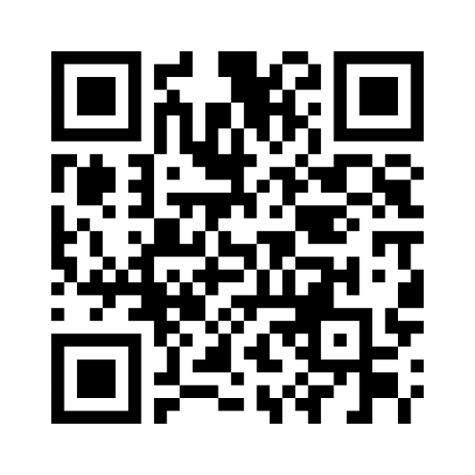
Pwy sydd yn yr ystafell?
Who is in the room?
https://www.menti.com/alqiqpjfe8hy

Slide 3
Cadw tŷ
Dim larwm tân wedi'i gynllunio
Gadael tân a chynulliad
Toiledau
Te a choffi
Bydd cinio yn cael ei weini yn yr ystafell hon
Gofod tawel
Bydd pwyntiau pŵer a gwybodaeth yn cael eu rhannu
Ffotograffiaeth
AVOW STAFF
Housekeeping
No planned fire alarm ​
Fire exit and assembly ​
Toilets ​
Tea and coffee ​
Lunch will be served in this room
Quiet space ​
Power points and information will be shared
Photography
AVOW staff ​

Slide 4
9.15 - 9.45 | Amser cyrraedd a rhwydweithio | Arrival and networking time
9.45- 9.55 | Trefn y Cynhadledd ac agenda | Housekeeping and agenda
9.55 - 10.05 | Croeso gan Brif Swyddog AVOW | Welcome from AVOW Chief Officer
10.05- 10.25 | Prif araith - Abigail Tweed | Keynote speech - Abigail Tweed
10.25 - 11.25 | Effaith – Leah Pybus | Impact – Leah Pybus
11.25 - 11.45 | Egwyl Cysur a rhwydweithio | Comfort Break & networking
11.45- 12.15 | Trafodaeth y panel: Cyllidwyr Ymddiriedolaeth – Cronfa Cymuned y Loteri Genedlaethol, Sefydliad Neumark a Sefydliad Cymunedol Cymru | Panel discussion: Trust Funders – The National Lottery Community Fund, The Neumark Foundation and Community Foundation Wales
12.15 - 12.45 | Trafodaeth panel: Partneriaethau corfforaethol llwyddiannus | Panel discussion: Successful corporate partnerships
12.45 - 13.30 | Cinio a rhwydweithio | Lunch and networking

Slide 5
13.30 - 13.45 | Cynnull ar ôl cinio – mynd i weithdai | Convene after lunch – go to workshops
13.45 - 14.45 | Opsiynau sesiwn: 1.Llywodraethu 2.Cyllid 3.Dyngarwch | Session options: 1.Governance 2.Finance 3.Philanthropy
14.45 - 14.50 | Symud i weithdy yn y brif ystafell | Move to workshop in main room
14.50 - 15.35 | Sesiwn Gwell Gyda'n Gilydd: 1. Cyd-ariannu 2. Anghenion hyfforddi a datblygu ar y cyd 3. Rhannu adnoddau a gwybodaeth | Better Together session: 1. Joint funding 2. Joint training and development needs 3. Sharing resources and knowledge
15.35 - 15.50 | Rhannu dysgu o'r diwrnod | Sharing learning from the day
15.50 - 16.00 | Adborth a Chau | Feedback and Closing
16.00 - 16.15 | Rhydweithio | Networking

Slide 6
We just want to know what we are doing is correct
Rydyn ni eisiau gwybod bod yr hyn rydyn ni'n ei wneud yn gywir
Networking and generating excitement
Rhwydweithio a chreu cyffro
Validation of our governance practice
Dilysu ein harfer llywodraethu
Ways to grow without losing what makes us individual
Ffyrdd o dyfu heb golli'r hyn sy'n ein gwneud ni'n unigol
How should we approach funders that we don’t have an existing relationship with?
Sut dylem fynd at gyllidwyr nad oes gennym berthynas bresennol â nhw?
Beth mae pobl eisiau ei gael o'r digwyddiad?
What do people want to get from the event?

Slide 7
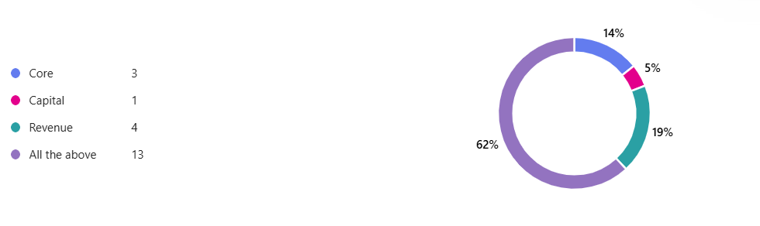
Pa gyllid rydych chi'n chwilio amdano?
What funding are you looking for?

Slide 8
Croeso! / Welcome!
Dawn Roberts-McCabe
Prif Swyddog AVOW/ Chief Officer AVOW

Slide 9
Prif Araith / Keynote Speaker
Abigail Tweed
Milestone Tweed

Slide 10
Prif Araith / Keynote Speaker
Dr Leah Pybus
Trust Impact

Slide 11
Sesiynau Ddewisol
Break Out Sessions

Slide 12
Cyllidwyr Ymddiriedolaeth
Trust Funders
Catriona Learmont Swyddog Grantiau /Grant Officer,
The National Lottery Community Fund (TNLCF)
Rosalind Williams Swyddog Grantiau /Grant Officer,
The Neumark Foundation
Alice King Swyddog Grantiau /Grant Officer,
The Community Foundation Wales
Trafodaeth Panel
Panel Discussion

Slide 13
Partneriaethau Corfforaethol
Corporate Partnerships
Christine D Lovelady,
DTCC
Kasia Williamson
Read Construction
Jane Pritchard
AICO
Trafodaeth Panel
Panel Discussion

Slide 14
Sesiynau Ddewisol
Break Out Sessions
Atgoffa dweud wrth bobl ble i fynd ar ôl cinio
Reminder tell people where to go after lunch

Slide 15
Cinio a Rhwydweithio
Lunch and Networking

Slide 16
Better Together
Collaborating to achieve our goals
Gwell Gyda'n Gilydd
Cydweithio i gyflawni ein nodau

Slide 17
Partnership working
Why it's important
'
Gweithio Mewn Partneriaeth
Pam ei fod yn bwysig

Slide 18
Kelly Huxley Roberts
Lloyds Bank Foundation for England and Wales

Slide 19
Partnerships
Local examples
Partneriaethau
Enghreifftiau lleol

Slide 20
Gwell Gyda'n Gilydd:
Cydweithio i gyflawni ein nodau
Better Together:
Collaborating to achieve our goals
Beth yw eich gobeithion ar gyfer cydweithredu? / What are your collaboration hopes?
We are looking for engaging sessions for our warm hub members (55+)
We are looking for somewhere to go for an away day in June
We want to end homelessness in Wrexham
Beth yw eich anghenion hyfforddi? / What are your training needs?
Pediatric First Aid
Safeguarding level C
Food Safety

Slide 21
How can we work in Partnership
What can you offer other not for profit organisations?
Discounted room hire for non-profits
Lived experience
Training on Inclusion and Diversity for non-profits
What equipment can you share?
PA system
Collection Tins
Bingo machine and Board games

Slide 22
Beth fyddwn ni'n ei gymryd i ffwrdd:
What will we take away:
Beth ydych chi wedi'i ddysgu?
What have you learnt?
Beth wnewch chi o ganlyniad i heddiw?
What will you do as a result of today?
Pwy /beth wnaeth eich ysbrydoli?
Who / what inspired you?
https://www.menti.com/alqiqpjfe8hy

Slide 23
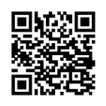
Feedback:
http://tiny.cc/avow_fbck_conference

Slide 24
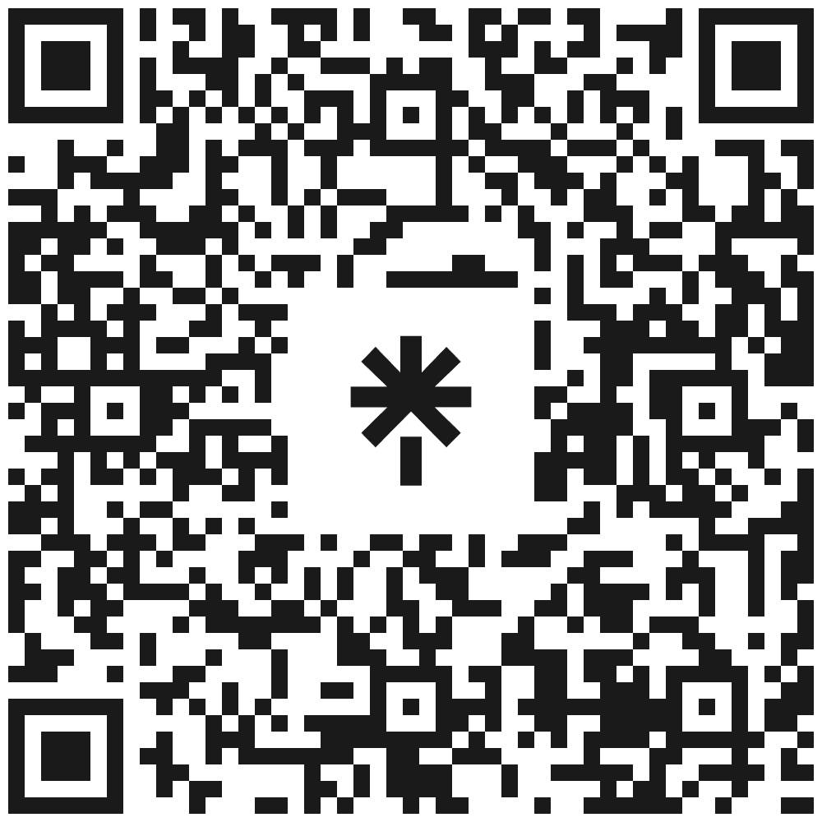
Camau Nesaf / Next Steps:
- Cefnogaeth ariannol / Funding support – jo.young@avow.org
- Cefnogaeth llywodraethu /Governance support – amy.jones@avow.org
- Hyfforddiant Ar-lein Am Ddim / Free Online Training
- Ymunwch â'ch cyngor gwirfoddol Sirol lleol (CGS) /
Join your local County voluntary council (CVC)
- Os hoffech chi ymuno ag AVOW heddiw gweler Sarah / If you would like to join AVOW today see Sarah
- Sesiynau gweithio partneriaeth / Partnership working sessions
- Rhwydweithiau – gwirfoddoli, iechyd a lles / Networks – volunteering, health and wellbeing

Slide 25
Ddiolch Yn Fawr!
Cadw mewn cysylltiad
Thank you!
Keep in touch

