Slide 1

Charity Training
8 May 2025
wrpartners.co.uk

Slide 2
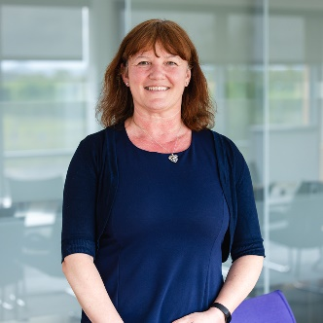
Who to contact
  Jane Tweedie
  Senior Manager
  jtweedie@wrpartners.co.uk

Slide 3
Agenda
Regulatory framework and accounting requirements
Internal controls
Fraud
Support for charities

Slide 4
What is a charity?
Not for profit
Purpose must be for the public benefit
Regulated by the Charity Commission
Different structures:
  Unincorporated trust
  CIO
  Limited by guarantee company
  Governed by a Board of Trustees/directors who are not usually involved with the day to day running of the charity

Slide 5
Regulatory Framework
Charity SORP 2019 – interpretation of UK accounting standards for the charity sector
Charities Act 2011
Companies Act 2006

Slide 6
Charities Accounting Requirements
All charities must prepare accounts and make them available on request
All CIO’s and all registered charities with income> £25k must file accounts and an annual return with the Charity Commission within 10 months of the year end
Charities with income between £10k and £25k only have to file an annual return at the Charity Commission
Limited Company charities have to file accounts at Companies House within 9 months of the year end

Slide 7
Charities Accounting Requirements
Small unincorporated charities can prepare receipts and payments accounts (income below £250k)
Larger charities and incorporated charities have to prepare accruals accounts in line with the Charity SORP
Some exemptions if income is below £500k (eg: no cash flow statement)
Audit required when income is > £1m or > £250k and assets are greater than £3.26m OR if required under the charity’s trust deed

Slide 8
Submitting accounts to the Charity Commission
Income level
Below £10k | Report income and spending
£10k – £25k | Answer questions in Annual Return but no need to include any other documents
Above £25k | Complete Annual Return Provide: Trustee Annual Report Accounts Independent examiner’s or audit report
The questions in the annual return will vary depending upon your income, the type of charity and your charitable activities

Slide 9
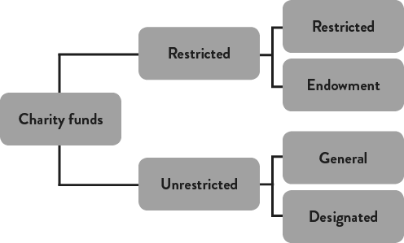
Funds

Slide 10
Funds
Restricted
Restricted – purpose is defined by the donor
Endowed – required under Trust law to invest the assets or (if land and buildings), retain them for the charity’s use. Any income arising from the assets can be spent
Unrestricted
General Funds – can spend on charitable objects at your discretion
Designated – funds which are formally earmarked for a specific purpose by the Trustees. They can remove the designation if circumstances change.

Slide 11
Financial Processes and Controls
Why are financial controls needed?
To protect your charity’s assets
To make informed decisions about your charity’s financial position
To meet your legal duty of manging your charity’s resources responsibly
To reduce the risk of fraud or error

Slide 12
Financial Processes and Controls
The types and levels of financial controls required will vary depending on:
Your charity’s size and structure
Where your charity operates
What your charity does
Controls must follow any requirements in your governing document

Slide 13
Internal controls – general principles
Understand the types of controls appropriate for your charity
Understand and monitor your charity’s financial information
Embed internal financial controls – lead by example
Review and monitor internal financial controls – at least once a year
Splitting financial responsibilities – segregation of duties
Vet new staff and volunteers
Take IT security seriously
Recording and reporting incidents – Action Fraud and the Charity Commission
Use the internal financial controls checklist

Slide 14
Financial Processes and Controls
Utilise Charity Commission Guidance
CC8 document which details the essential checks and procedures which help charity trustees
https://www.gov.uk/government/publications/internal-financial-controls-for-charities-cc8
Useful checklist
https://assets.publishing.service.gov.uk/media/643d596b773a8a000cab2dea/Checklist_Internal_financial_control_for_charities.odt

Slide 15
Fraud – Why are charities vulnerable?
    Reliance on altruism, trust and honesty – high degree of trust placed in staff and volunteers
    Often a higher level of cash transactions and balances
    Irregular/unpredictable income streams
    Presence of restricted funds
    Related party transactions
    Charity sector lost over £2.3m to fraud in 2022

Slide 16
Fraud – Trustees’ legal duties and responsibilities
Take reasonable steps to help prevent financial abuse of the charity’s funds in the first place
Make sure that proper robust financial controls and procedures suitable for your charity and its activities are in place
Ensure you act responsibly, and in the interests of the charity, when dealing with incidents of fraud

Slide 17
Fraud – Current position
  BDO fraud survey 2023
  43% of charities reported a fraud or attempted fraud (up from 36% last year)
  Most common frauds were
    The misappropriation of cash or assets - 42%
    Staff expenses fraud – 35%
    Payment diversion fraud – 33%
    Procurement fraud – 25%

Slide 18
Fraud
Main risk is internal fraud – carried out by a staff member, volunteer or trustee
Only 23% of frauds were carried out by someone with no connection to the charity
Highlights the importance of maintaining effective internal controls

Slide 19
Avoid conflicts of interest
Identify/declare conflicts
Prevent it affecting the decision
Record how it was dealt with
Need to demonstrate integrity, honesty and openness in how your charity operates

Slide 20
Act in your Charity’s best interest
Understand the charity’s interests
Make decisions.....
    in good faith
    being suitably informed
    taking independent advice when needed
    And record how you made them
Receive no payment for your work as a Trustee (unless permission received from Charity Commission)
Avoid conflicts of interest

Slide 21
Support for charities
Charity Commission - https://www.gov.uk/government/organisations/charity-commission
AVOW – amy.jones@avow.org
WR Partners:
jtweedie@wrpartners.co.uk
rmoore@wrpartners.co.uk
nmeyer@wrpartners.co.uk

