Slide 1


AVOW CONFERENCE 8TH MAY 2025
Unlocking the Power of Philanthropy for Small Charities

Slide 2
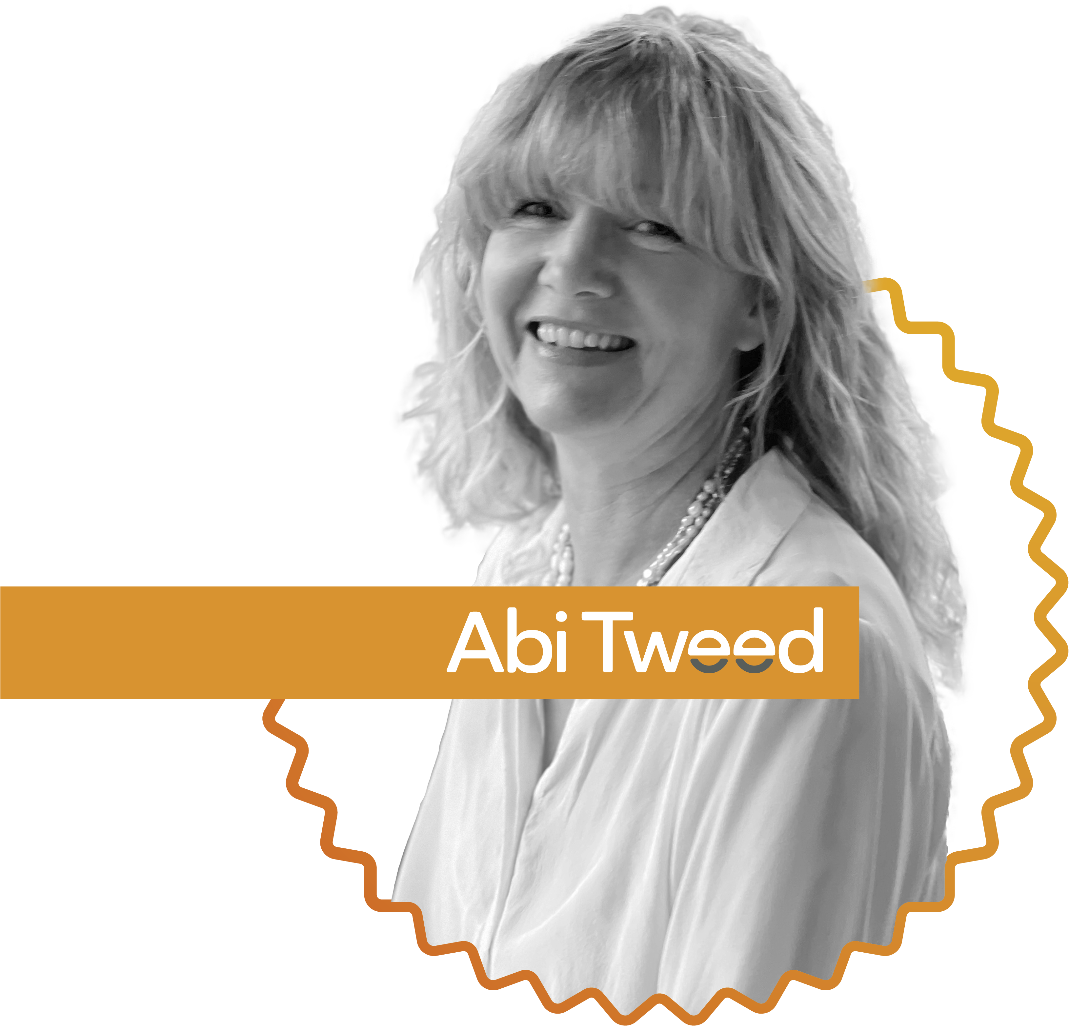

Organisational Development Consultant, Executive Coach & Director of milestone tweed

Slide 3
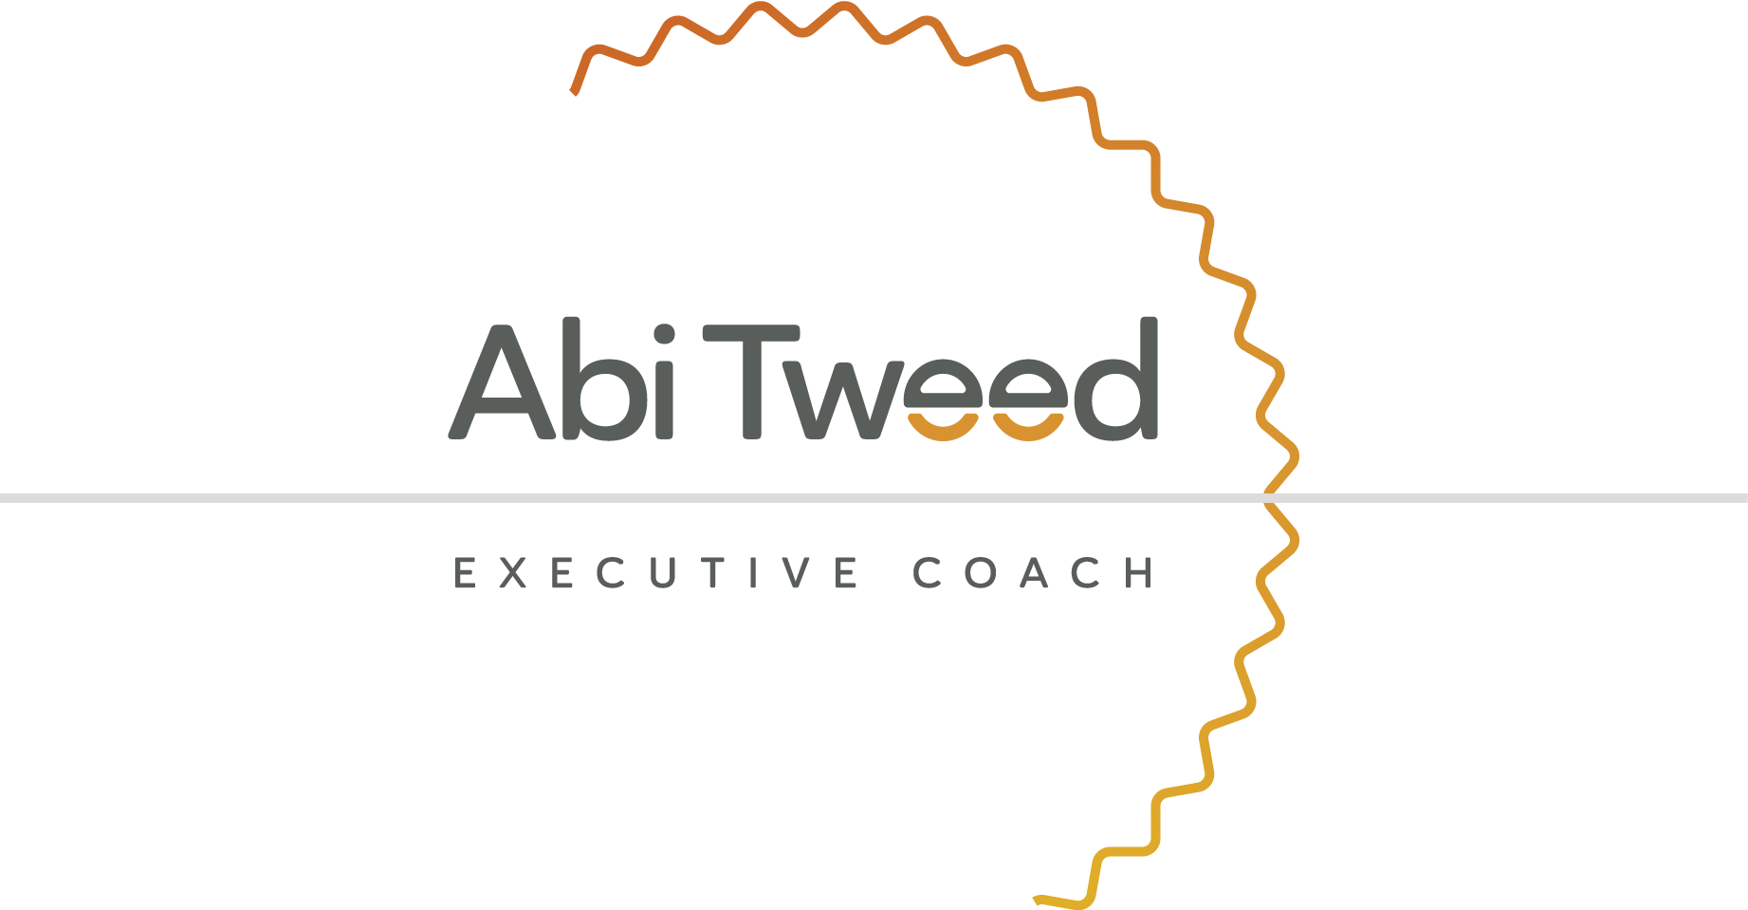
Philanthropy = φιλανθρωπία (philanthrōpía)
“love of humanity”

Slide 4
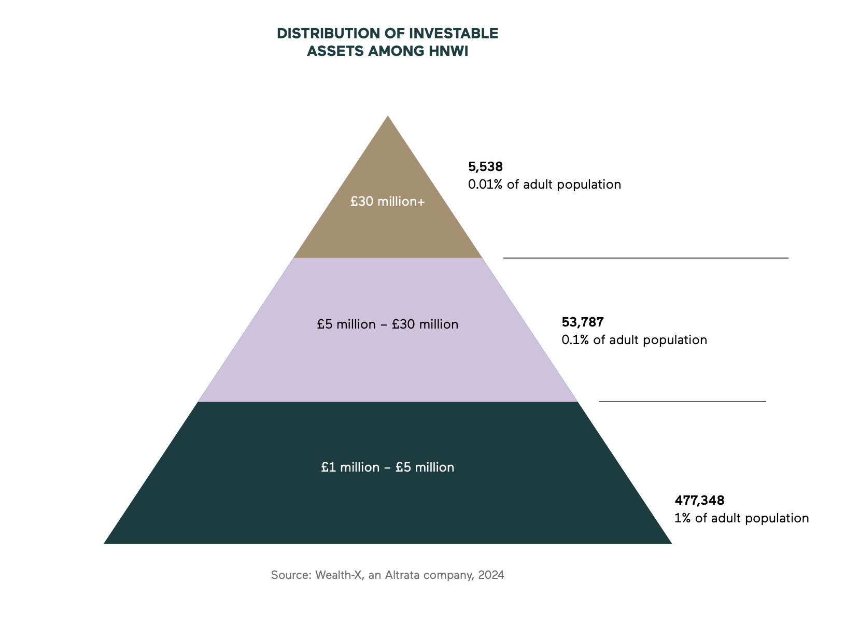

Slide 5
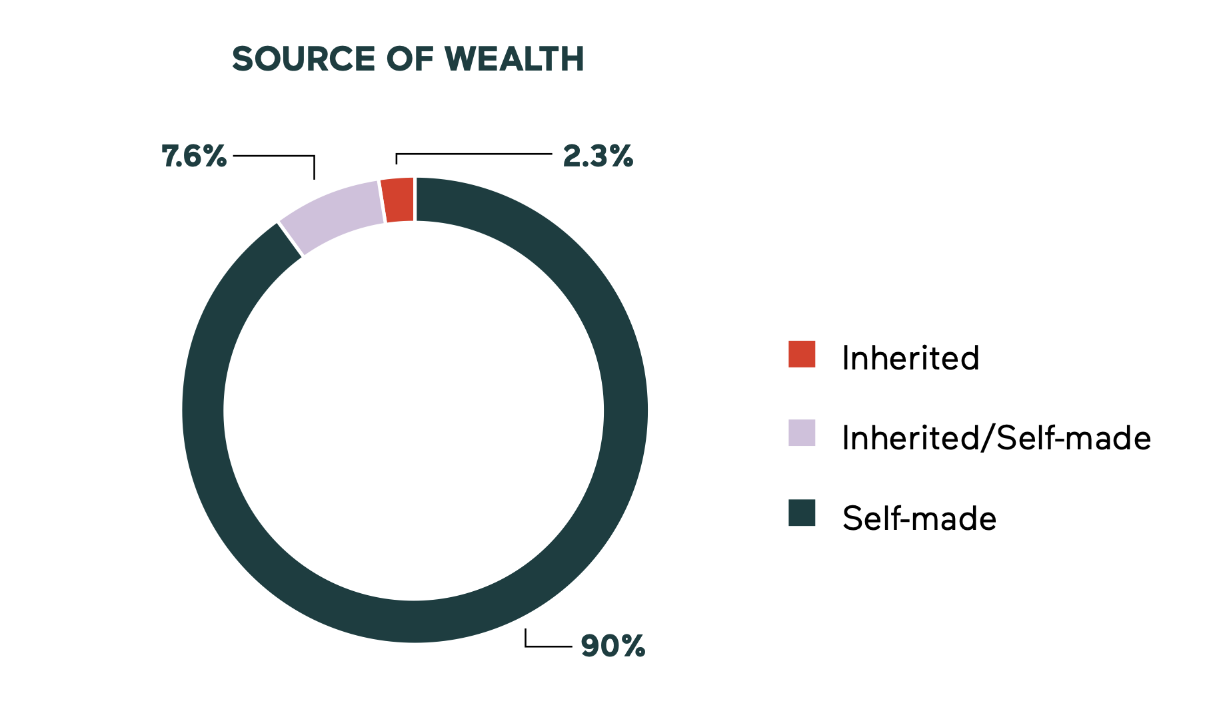

Slide 6
Do we need to change our mindset?

Slide 7
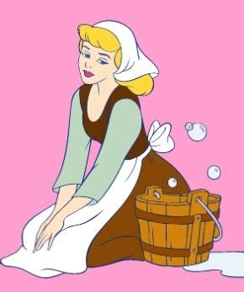

Slide 8


Slide 9
How investment-ready are we?

Slide 10
Do we have strong governance?
Up-to-date policies?
Clean finances?
Are we registered for Gift Aid?
How well can we communicate and
evidence our work and impact?

Slide 11
19% of people don’t trust charities to use their money wisely
CAF UK GIVING REPORT 2025:
TRENDS IN GIVING

Slide 12
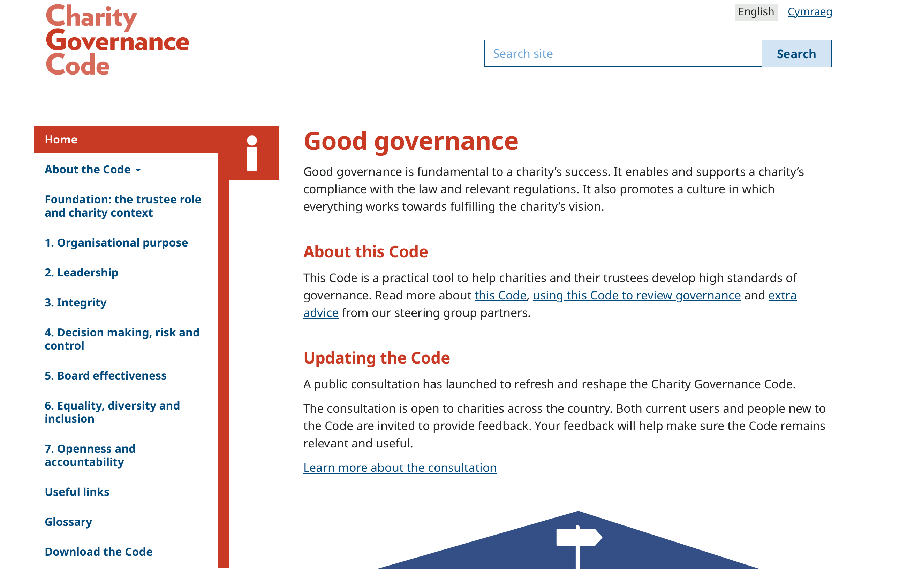

Slide 13
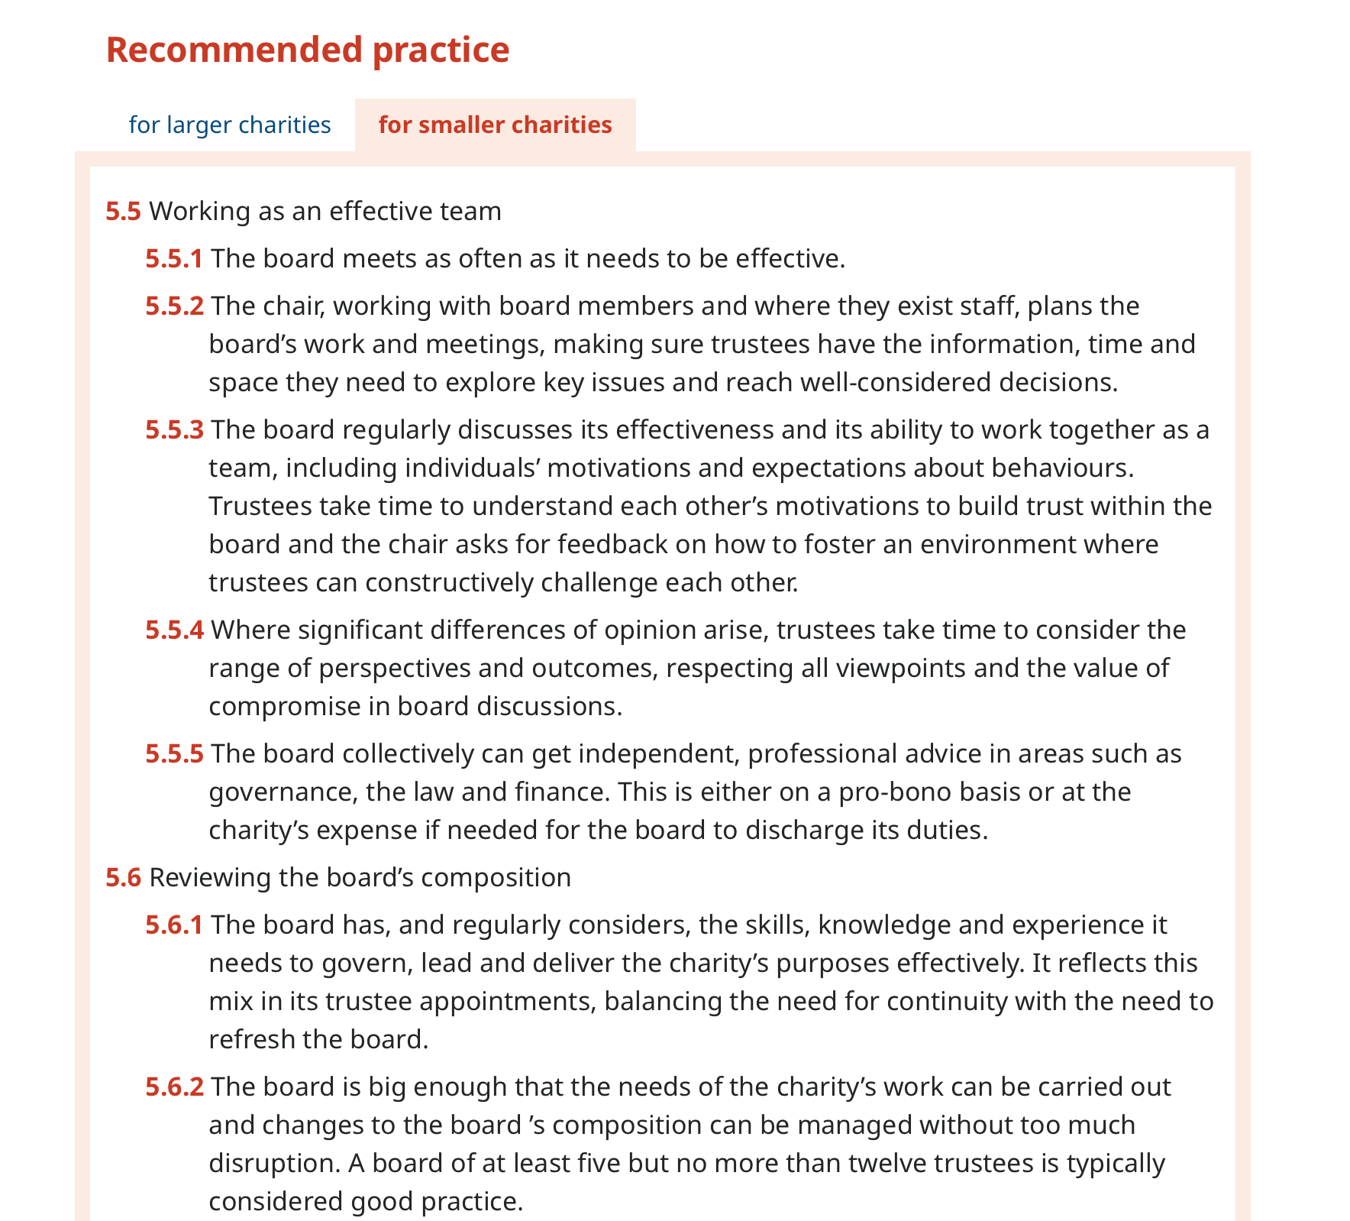

Slide 14
Theory of Change Definition
OLLATION
A Theory of Change is a systematic and visual way to present and share your understanding of the relationships among the resources you have to operate your organisation, the activities and projects you plan to do, and the changes or results you hope to achieve to make a difference.
STAKEHOLDERS
ACTIVITIES
OUTPUTS
OUTCOMES
IMPACT
RESOURCES / INPUTS
NEEDS / CHALLENGES

Slide 15
Why is Theory of Change useful and important?
Is often useful for helping funders and commissioners (and other stakeholders) to easily understand your work.
Transparency of vision and purpose.
A roadmap for achieving long-term goals.
To help prioritise your activities and time
To help focus your energy
Helps organisations define steps to bring about change.
Clarifies impact pathways.
Ensures clarity and alignment in strategy.
Helps track progress and evaluate impact.
Helps identify indicators and ways you can measure your impact.
Identifies key assumptions, needs and challenges.
It strengthens advocacy.
It supports programme and project design.

Slide 16
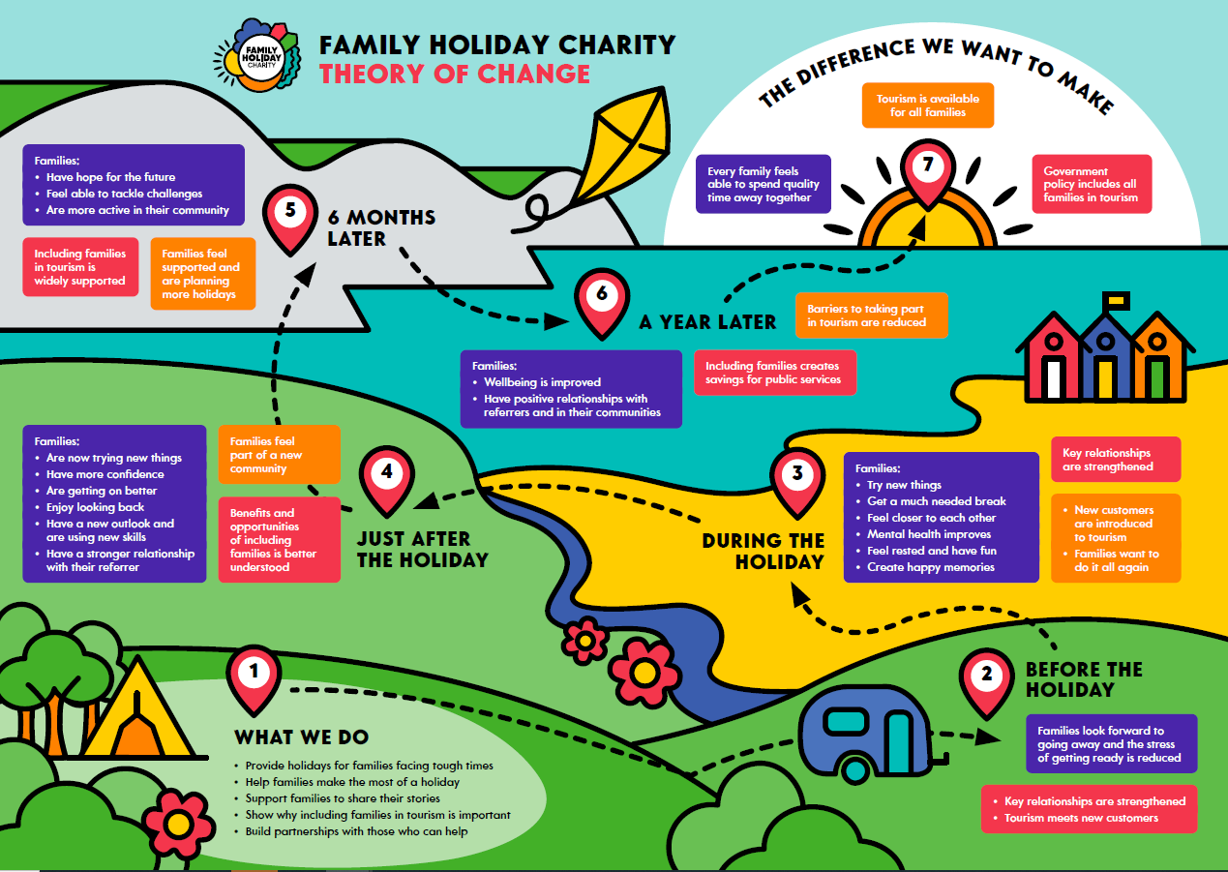

Slide 17
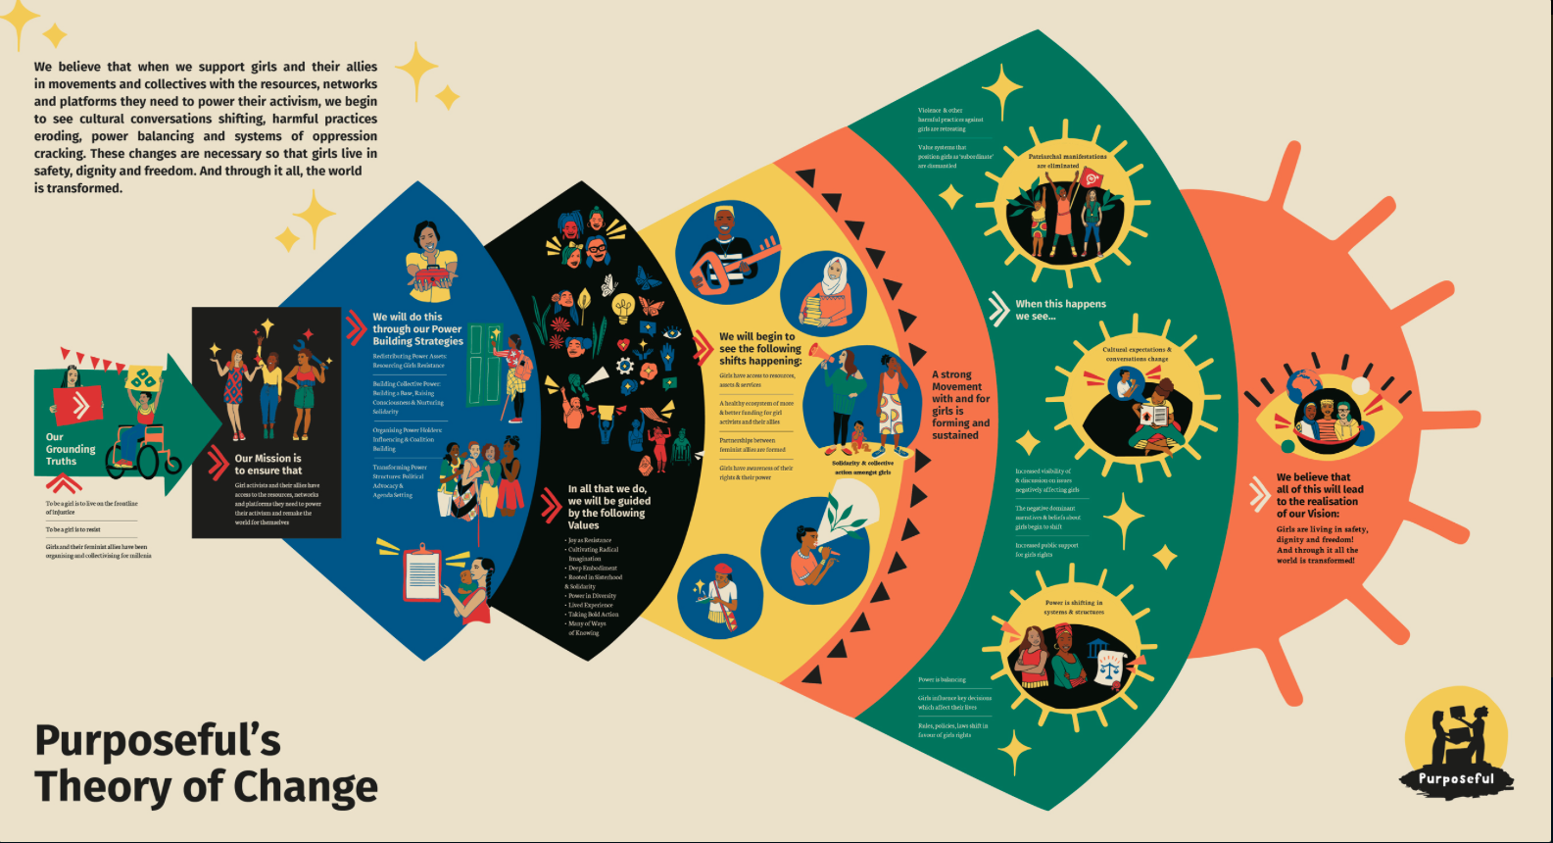
Notes:
Note this organization includes their values with their TOC
They don’t use the TOC terminology – so maybe more accessible
They use short term and long term outcomes
Not so much focus on needs / challenges
Less focus on stakeholders

Slide 18


Slide 19
How much capacity have I got?
Do you have time to develop relationships?

Slide 20
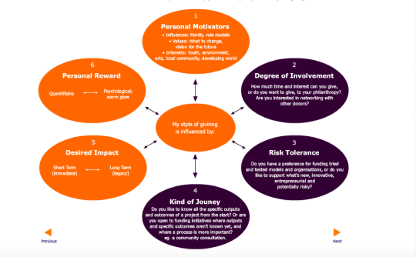

Slide 21
What mindset shift do I need?
How investment-ready are we?
What capacity can I build?

Slide 22
The one thing I’m going to do
as a result of my work today is……..

Slide 23


EXECUTIVE COACH &
ORGANISATIONAL DEVELOPMENT
CONSULTANT
milestonetweed.co.uk
abi@milestonetweed.com

